Slide 1

St. Louis Crime Data
Nick Nothdurft
Julie Parsell
Neal Lewis

Slide 2
Hypothesis
Our hypothesis predicts that there is a correlation between crime and time of year. Crime rates will fluctuate between day of the week, season, and lunar cycle.

Slide 3
Questions & Data
In order to prove our hypothesis we needed to find information on what crimes had been committed in St. Louis and what lunar phase happened on each day.

Slide 4


Research Questions
What season has the highest crime rate?
Are more crimes committed on the weekends?
Does the Lunar Phase correlate to crimes?
Are different types of crimes more prevalent during specific times of the year?

Slide 5
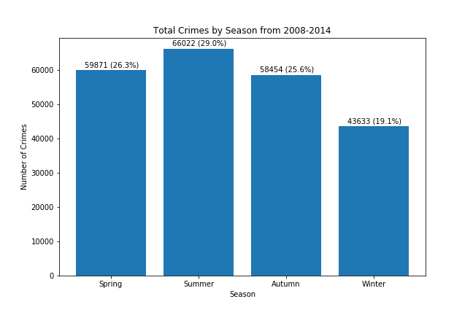
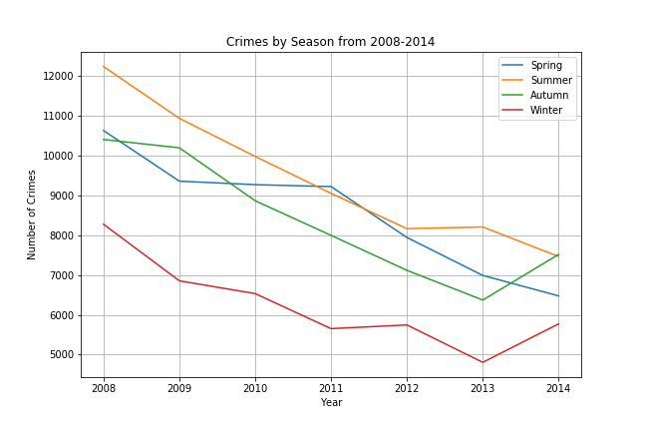
Seasonal Crime

Slide 6
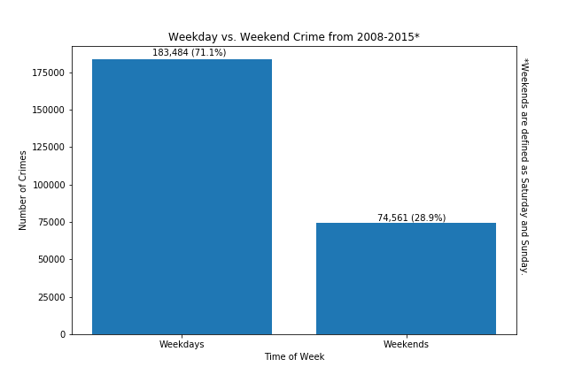
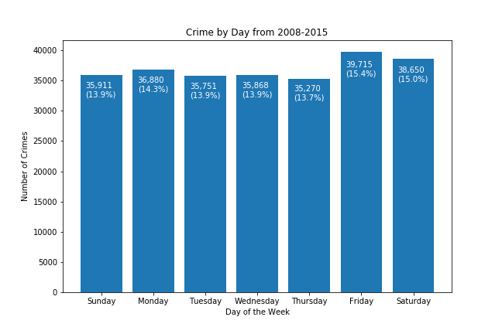
Weekend Crime

Slide 7
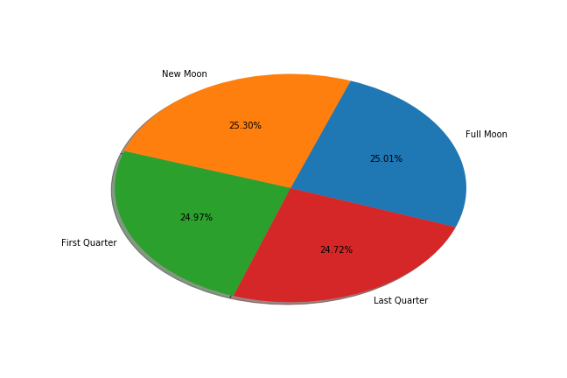
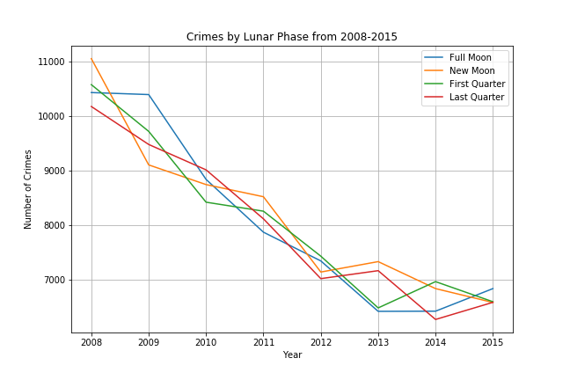
Lunar Crime

